Slide 1
Wordpress Blog
Completely customizable blogging.

Slide 2
Brief Overview
What is a blog?
What is WordPress?
Why is WordPress superior?
Cool themes
How to get WordPress?
Conclusion

Slide 3
Blogs
A simple definition.

Slide 4
Definition
A blog is a website where entries are written in chronological order and commonly displayed in reverse chronological order. "Blog" can also be used as a verb, meaning to maintain or add content to a blog.
Many blogs provide commentary or news on a particular subject; others function as more personal online diaries. A typical blog combines text, images, and links to other blogs, web pages, and other media related to its topic.
wikipedia.com

Slide 5
WordPress
What is?

Slide 6
Explanation
WordPress is a blog publishing system written in PHP (Personal Home Pages) and backed by a MySQL database.
This blog software allows the user to control every aspect of the blog unlike most leading blog spot providers.
wikipedia.com

Slide 7
Superior
Why?

Slide 8
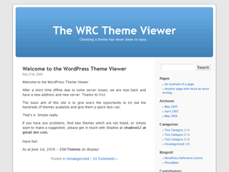
It’s Just Better
WordPress is software configured by YOU.
Access to your database 24/7
Customizable themes
Customizable interface
Don’t have to worry about provider web site downtime
Super easy to use
Will help you learn how to use a development database system.

Slide 9
Themes
Tons of creative choices.

Slide 10
Getting Started
What to do.

Slide 11
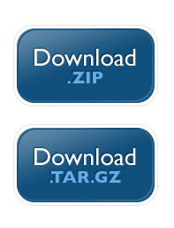
Downloading
Visit the WordPress website at http://wordpress.org/download/.
Download .zip.
Unpack.
Create a database on iSpace.
Edit the configuration file.
Upload the files.
Blog authentication.
Blogging.
This will be expanded in more detail on my video.

Slide 12
Conclusion
What we learned.

Slide 13
Conclusion
A blog is a way people can express themselves on the net.
WordPress is a blog publishing software.
With many customizable features WordPress has it’s advantages.
Cool themes makes WordPress fun.
Getting WordPress is really easy.
my blog

